Slide 1
80386
First Generation 32–Bit microprocessor

Slide 2
80386
There were a few different versions of the 80386 CPUs:
  80386DX - this CPU could work with 16-bit and 32-bit external buses.
  80386SX - low cost version of the 80386. This processor had 16 bit external data bus and 24-bit external address bus.
  80386SL - low-power microprocessor with power management features, with 16-bit external data bus and 24-bit external address bus. The processor included ISA bus controller, memory controller and cache controller.
The Intel 80386 was produced at speeds up to 33 MHz
AMD produced even faster 40 MHz version

Slide 3
Features
32-bit general and offset registers
16-byte prefetch queue
Memory Management Unit with a Segmentation Unit and a Paging Unit
32-bit Address and Data Bus
4-Gbyte Physical address space
64-Tbyte virtual address space
i387 numerical coprocessor with IEEE standard-754-1985 for floating point arithmetic
64K 8-, 16-, or 32-bit ports
Implementation of real, protected and virtual 8086 modes

Slide 4
80386 Modes
Real-address mode (often called just "real mode") is the mode of the processor immediately after RESET. In real mode the 80386 appears to programmers as a fast 8086 with some new instructions. It uses 1 MB of memory using the A0-A19 lines with A20 – A31 being inactive. It also uses the segmented memory scheme of 8086 with 64KB limitations. Most applications of the 80386 will use real mode for initialization only.
Virtual 8086 mode (also called V86 mode) is a dynamic mode in the sense that the processor can switch repeatedly and rapidly between V86 mode and protected mode. The CPU enters V86 mode from protected mode to execute an 8086 program, then leaves V86 mode and enters protected mode to continue executing a native 80386 program. Also, in the V86 mode, since it acts like 8086 the processor uses 1 MB chunks of memory to run programs. It can run mutliple 8086 programs in separated protected environments.

Slide 5
80386 Modes
Protected mode is the natural 32-bit environment of the 80386 processor.
In this mode all instructions and features are available. Although segmented memory scheme is retained, each segment can range from a single byte upto 4GB.
This mode supports ‘Virtual memory’ which is a technique that fools the processor into thinking that it has unlimited amount of physical memory. Two methods are used for this: ‘segmentation’ and ‘paging’.
Both methods involve swapping blocks of user memory with hard disk space as necessary. The main difference between segmentation and paging is that in segmentation the block is variable from one byte upto 4 GB but in paging block sizes are always 4 KB.
In protected mode individual tasks (user programs) can be assigned privilege levels which implies that a task with lower privilege cannot access programs or data in a segment with higher privilege levels. This allows for the processor to ‘Multitask’ or in other words run multiple programs without one program interfering with the other

Slide 6
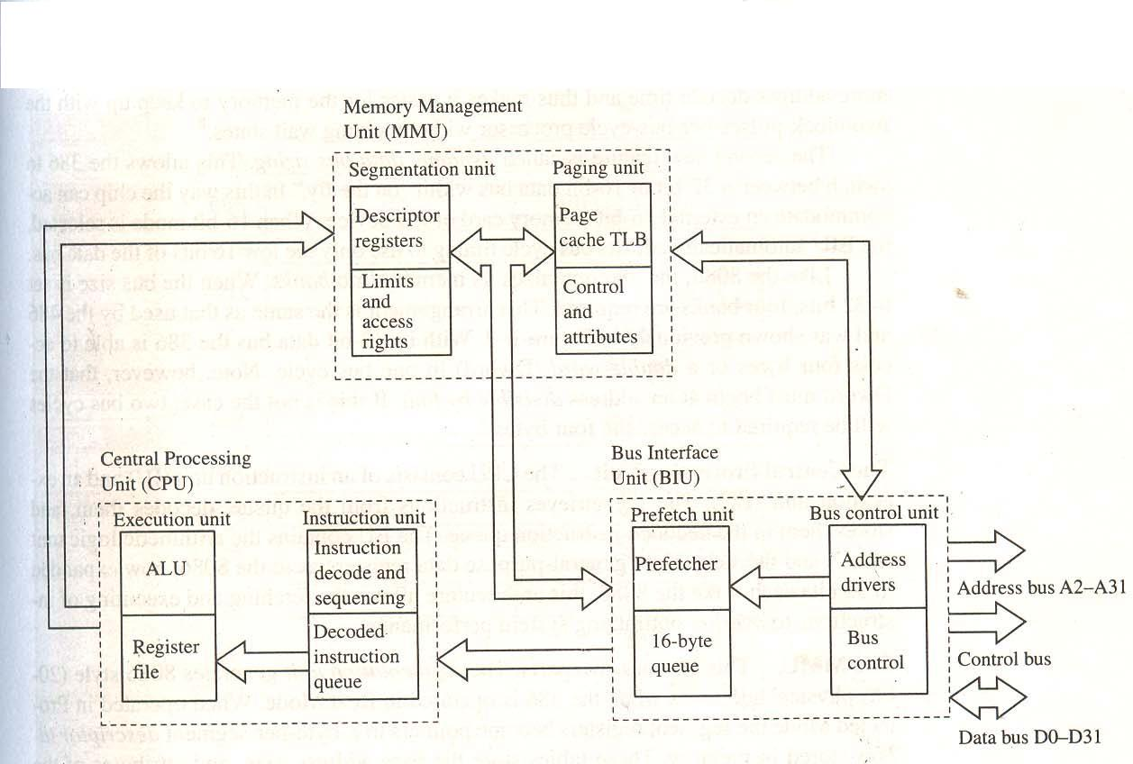
Block Diagram

Slide 7
The BIU
This unit manages the 32-bit address and data buses of the 386 as well as the various control signals. Similar to the 8086’s BIU, its job is to keep the instruction queue(here 16B) full so that the processor never has to wait for an instruction to fetch.
Two new features have been added; address pipelining and dynamic data bus sizing.
Pipelining is a method in which the address of the next memory cycle to be accessed is output by the 386 halfway through the current bus cycle. This makes it easier for the memory to keep up with the two clock pulses per bus cycle of the processor without adding wait states.
Dynamic data bus sizing is a method in which the 386 can switch between a 32-bit or 16-bit data bus width “on the fly”. In this wat the chip can accommodate an external 16-bit memory card or I/O device.

Slide 8
CPU
The CPU consists of an instruction unit and EU. The IU retrieves instructions from queue, decodes them and stores them in the decoded instruction queue. The EU contains the ALU and the same eight general purpose data registers as in the 8086 just that the registers in the 386 are 32 bit wide.

Slide 9
MMU
This unit has two parts. The segmentation unit and paging unit.
The segmentation unit generates 8086 style address when the 386 is operated in real mode. When in protected mode the segment registers become pointers to 8 byte per segment descriptor tables stored in memory. These tables store the base address, size, and attributes of the various segments.
To ensure fast memory access, the MMU stores a copy of these tables.

Slide 10
MMU
The paging unit. With this unit the 386 accesses memory 4KB pages instead of variable length segments.
Typically, only the most current pages are kept in memory with the others swapped out to disk. In this way, programs that actually require more memory than is physically present can be run.
Because considerable time may be required to locate the specific 4 KB page frame referred to by a computer instruction, the MMU stores the address of the 32 most recently used pages in the page cache.
The page cache is also called translation look aside buffer (TLB).

Slide 11
Coprocessor 80387
Coprocessors produce an increase in performance for certain applications.
In general a coprocessor is a mathematical coprocessor that supports the CPU in calculating complicated mathematical expressions in hardware.
The i387 is the coprocessor for the i386. The i387 provides hardware support for floating point arithmetic. The i386 can execute all mathematical expressions on its own using software emulation of the i387. The i387 can run floating point operations at much higher speed.

Slide 12
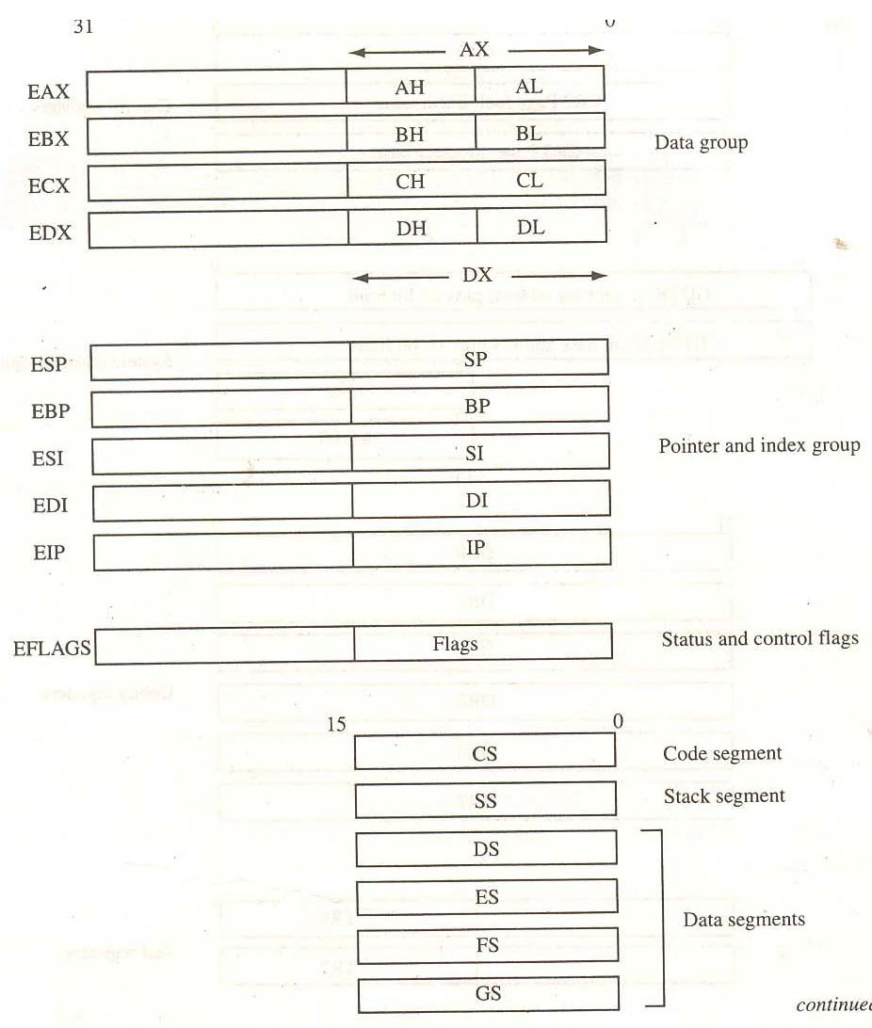
Basic Programming model

Slide 13
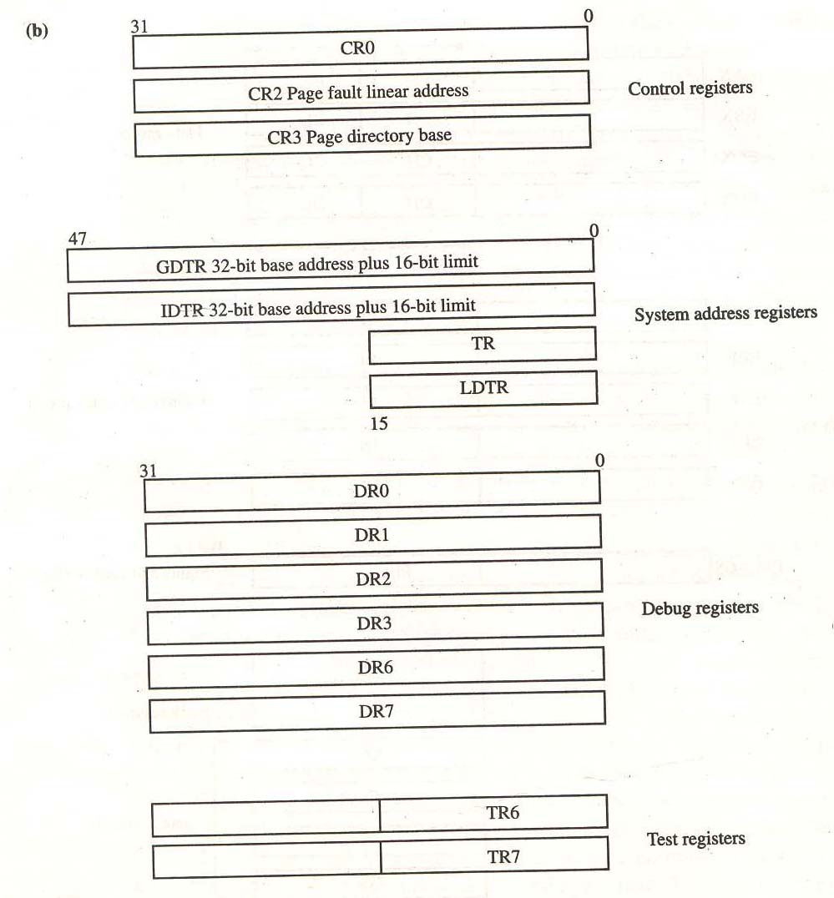

Slide 14
Registers
80386 programming model contains two parts: the general purpose registers used by applications and programs, and the special purpose register used by the operating system
  General purpose registers
  Data and address group. These are the data, pointer and index registers from the 8086 and have been updated to 32 bits.
  Status and control flags. The flag has been expanded to 32 bits. And are discussed later.
  The segment group. Two new segment registers FS and GS have been added. So that six different segments can be active at a time. Each segment register is 16 bits wide as in 8086 but no instructions default to the FS and GS segments, therefore allowing them to be used dynamically.

Slide 15
  Control registers
  These registers are not normally used by the programmer as they are intended to control the processor in protected mode and for testing.(associated with virtual memory uses)
  System address registers
  Hold information about the descriptor tables used in protected mode.
  Debugging registers
  They are used to set breakpoints from which the program should pause and allow debugging routines to be run.
  Test registers
  There are two test registers. They are used by the paging unit to quickly translate virtual memory addresses into physical addresses.

Slide 16
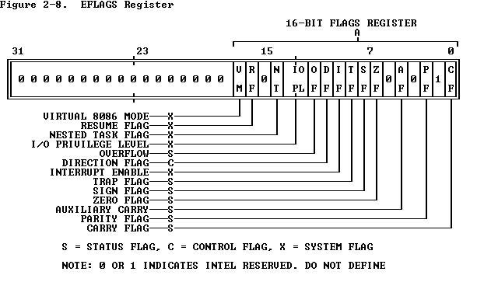
Flag Register

Slide 17
Flag Register
System Flags
  IOPL Flag: This is a 2-bit field and supports 80386 protection feature. This states the current privilege level required to execute I/O instructions.
  NT Flag: The processor uses the nested task flag to control chaining of interrupted and called tasks. NT influences the operation of the IRET instruction.
  RF Flag: The RF flag temporarily disables debug exceptions so that an instruction can be restarted after a debug exception without immediately causing another debug exception.
  VM Flag: When set, the VM flag indicates that the task is executing an 8086 program in virtual mode.

Slide 18
Paging
Paging is more popular than segmentation due to a disadvantage in the technique known as memory fragmentation.
Memory fragmentation occurs when the computer attempts to manage variable length memory segments. Like the file space on a disk drive, the available memory becomes fragmented into small unusable pieces in the sense that they are too small to accommodate additional program segments. This in turn causes the OS to spend a lot of time moving files back and forth to locate sufficient free memory space for new files
Advantage of paging: with paging fragmentation is avoided by dividing the available memory space into 4 KB chunks or “pages”. Because these pages are relatively small and are all the same size the OS can pack them into memory more efficiently. Also, since fixed length pages are easier to keep track of than variable length segments the OS can respond more quickly.
The paging mechanism uses two levels of address translation. The A31-A22 bits(10bits) are used to create a page directory table which holds addresses for 1024 4MB blocks. Then the A21-A12(10bits) addresses hold the base addresses for each 4KB segment and is known as the address translation table. The final 12 bits are used to access data within each 4KB page.

Slide 19
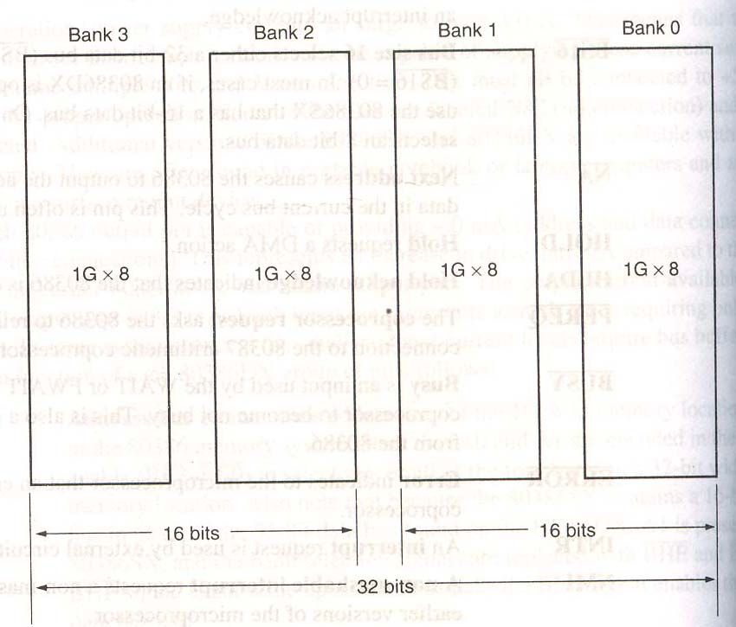
80386 Memory

Slide 20
80386 Memory
The physical memory of the 386 is 4Gb but if virtual addressing is used, 64TB of memory can be supported by means of memory management units and descriptors.
The 80386 memory is divided into 4 8-bit wide memory banks each of which are 1GB in size. This 32 bit wide memory organization allows for bytes, words or double words to be accessed directly.
In the 80386 the four banks are accessed via the BE3’-BE0’ pins (similar to the A0 and BHE’ in 8086).
In most cases a word is accessed from bank 0 and 1 or 2 and 3. Memory location 00000000h is in bank 0 00000001h is in bank 1 00000002h is in bank 2 and 00000003h is in bank 3 and so on.

